Slide 1
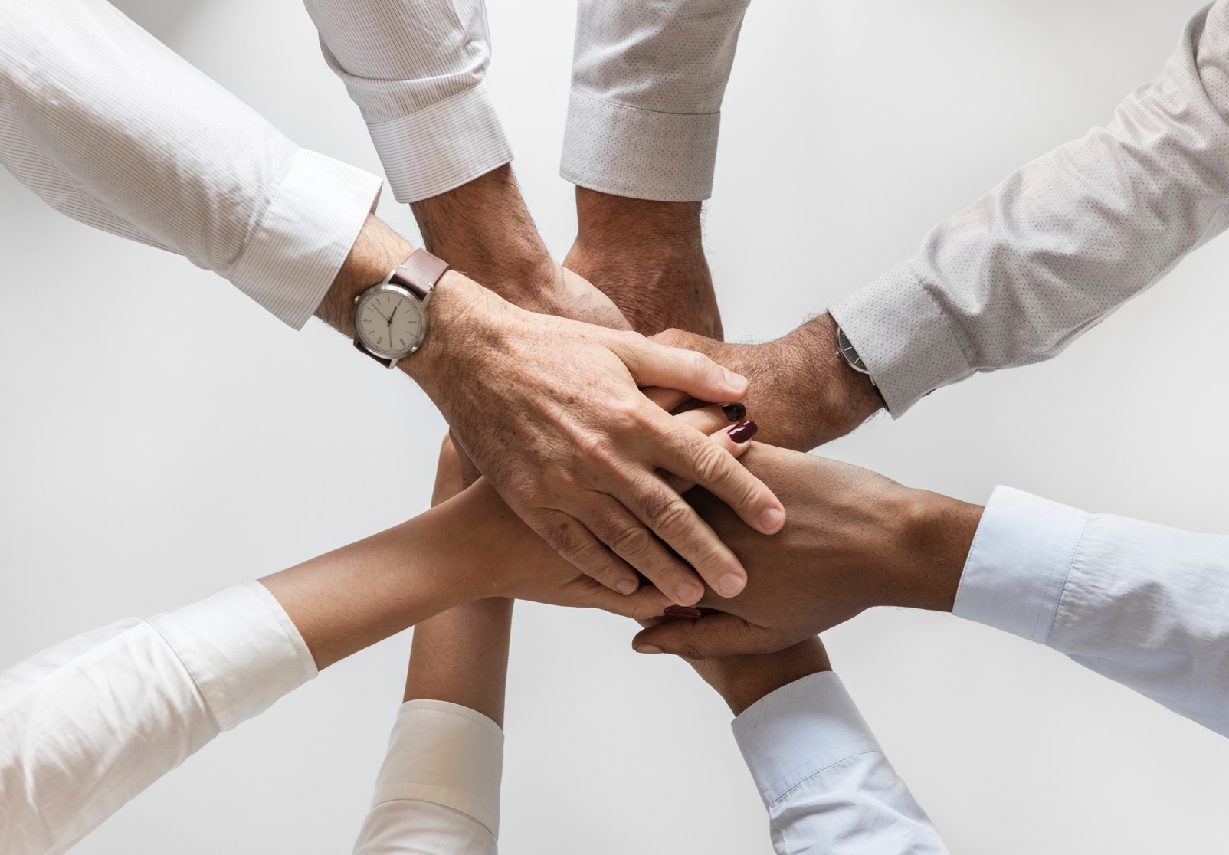
WEB DEVELOPMENT
CheckPoint One

Slide 2

SOMMAIRE
CheckPoint Objective
How does the web work.
What do you need to be web developer.
Why did you choose to learn web developer.

Slide 3
How does the web work Web means World Wide Web, it is a system of interconnected documents and resources that accessed over the internet. It allows users to navigate between a websites and web pages. A client sends a request, using a URL, to a server which hosts the website or web application. When you enter a URL in the browser, it contacts a Domain Name System (DNS) server to resolve the domain name into an IP adresse, and the ip adresse identifies the server that host the website. The server processes it based on the requested resource and the server sends an HTTP response to the client.

Slide 4
What do you need to be web developer. To become a web developer, there is several skills and knowledge that are important to acquire: 1- HTML, CSS, and JavaScript : These 3 fundamental technologies are the building blocks of web development. 2- Programming languages and Frameworks 3- Version Control 4- Server-side Language and databases

Slide 5
Why did you choose to learn web developer. I choose to learn Web developer because i love IT first and for entrepeuneuriat opportunities. Web developer skills will empower me to start my own business. I choose this business because of love and because of flexibility and remote opportunities.

Slide 6
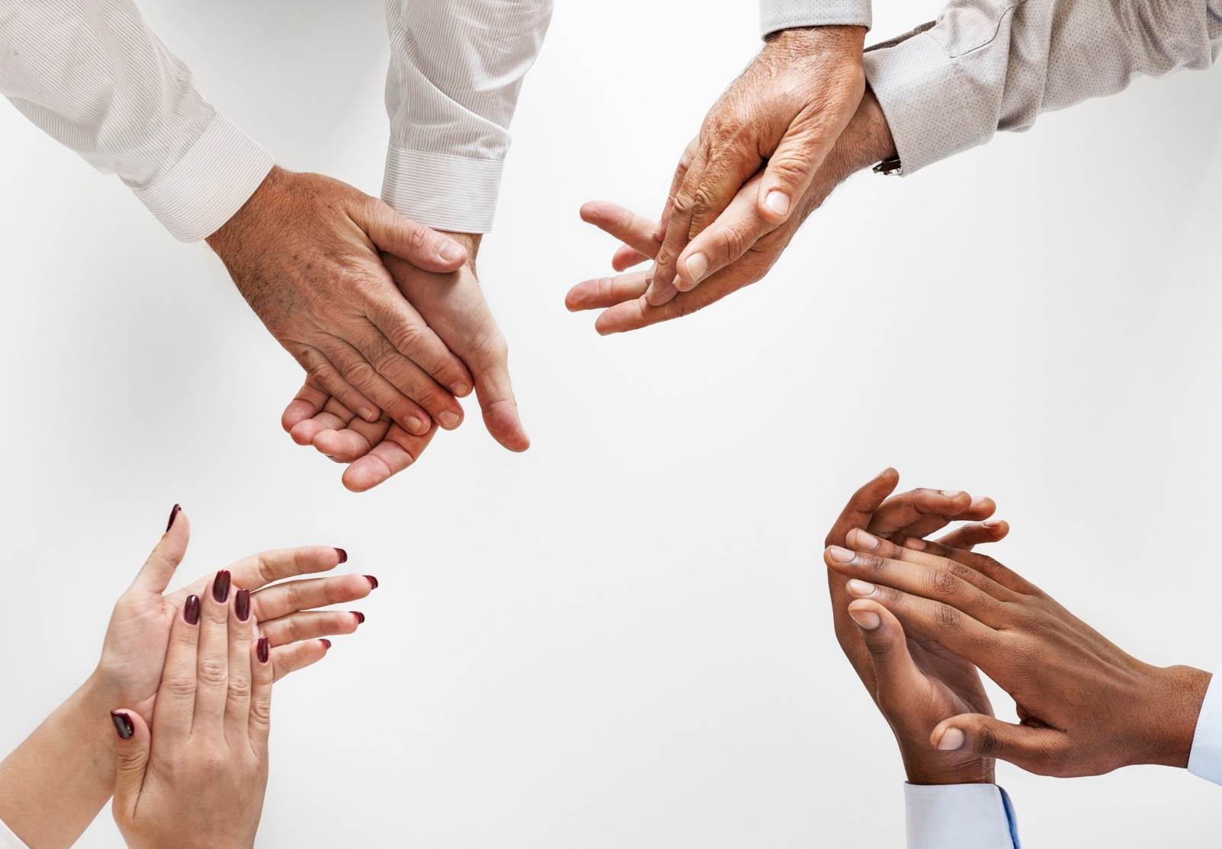




Thank You
Edith Flore BOUKOUE
514-546-1476
floreedith96@yahoo.com
Checkpoint

